Slide 1

Hypothesis Testing
Chapter 9

Slide 2
Objectives
Read textbook sections 9.1 – 9.4.
State the null and alternate hypotheses.
Compute the test statistic and p-value.
Understand the concept of a significance level.
Interpret the results and make an appropriate conclusion.
Determine whether an error has been made.
Hypothesis testing is a method of estimating an unknown parameter. We use probability to determine the likelihood of two competing hypotheses. In this course, we will perform hypothesis tests to estimate means and proportions.

Slide 3
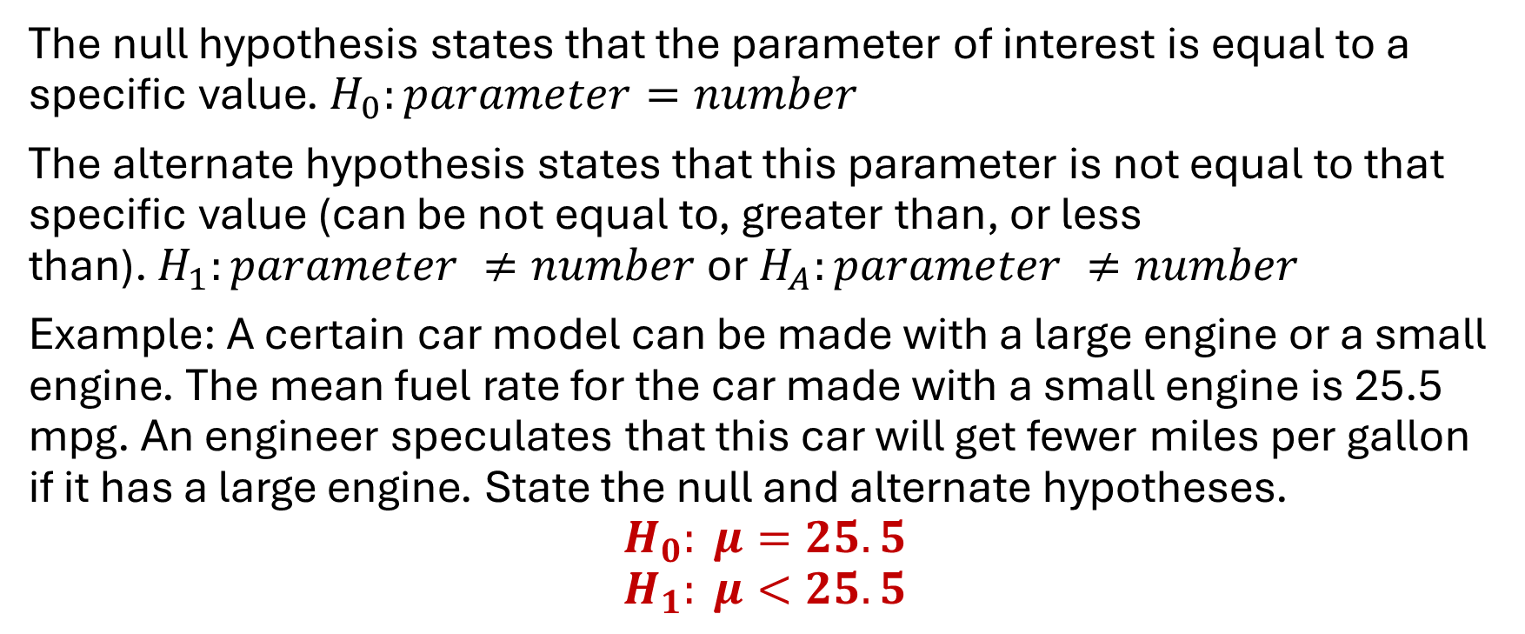
Null Hypothesis vs. Alternate Hypothesis
The null hypothesis states that the parameter of interest is equal to a specific value. $H_{0}:parameter=number$
The alternate hypothesis states that this parameter is not equal to that specific value (can be not equal to, greater than, or less than). $H_{1}:parameter ≠number$or $H_{A}:parameter ≠number$
Example: A certain car model can be made with a large engine or a small engine. The mean fuel rate for the car made with a small engine is 25.5 mpg. An engineer speculates that this car will get fewer miles per gallon if it has a large engine. State the null and alternate hypotheses.
$$H_{0}: μ=25.5$$
$$H_{1}: μ<25.5$$

Slide 4
One-tailed vs. Two-tailed Tests
A one-tailed test can be either left-tailed or right-tailed. *Draw pictures
Example - µ < 25.5 “less than” means left-tailed.
Example - µ > 25.5 “greater than” means right-tailed.
A two-tailed test is less specific.
Example - µ ≠ 25.5 “not equal to” means two-tailed.

Slide 5
Stating Hypotheses Practice
Last year, the mean amount of money spent per customer at Los Pollos Hermanos was $17.45. The owner hypothesizes that the mean will be higher this year.
One measure of air pollution is particulate matter (PM). Five years ago, Gotham City had a mean measure of 35 mg of PM per mile of travel. This year, Dr. Pamela Isley is curious to know if this value has changed.
In 2021, the proportion of KSU graduates who majored in Biology was 5%. The admissions department is curious to know if this proportion has decreased.

Slide 6
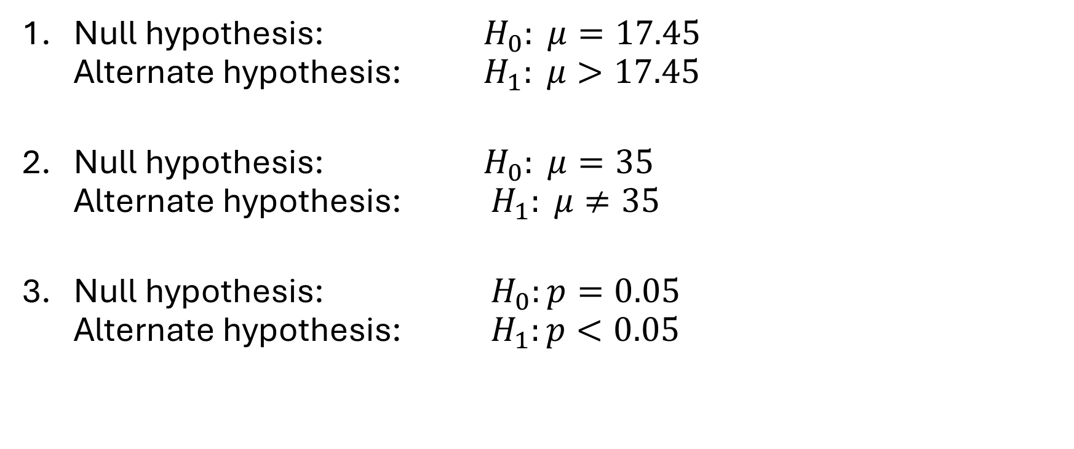
Stating Hypotheses Solutions
Null hypothesis: $H_{0}: μ=17.45$
Alternate hypothesis: $H_{1}: μ>17.45$
Null hypothesis: $H_{0}: μ=35$
Alternate hypothesis: $H_{1}: μ≠35$
Null hypothesis: $H_{0}:p=0.05$
Alternate hypothesis: $H_{1}:p<0.05$

Slide 7
Comparing a Hypothesis Test to a Criminal Trial
Hypothesis Test | Criminal Trial
Begin by assuming the null hypothesis is true. | Begin by assuming the defendant is innocent.
Evidence is presented (data is gathered and statistics are calculated). | Evidence is presented (forensics, testimonies, test results, photographs, etc.).
If the data indicates that the null hypothesis is false, we abandon the idea that it’s true. | If the evidence indicates that the defendant is guilty, we abandon the idea that they are innocent.
If the data fails to prove that the null hypothesis is false, then we fail to reject the null hypothesis. | If the evidence does not convince the jury that the defendant is guilty beyond a reasonable doubt, then they find the defendant not guilty.
A conclusion is stated to summarize the decision. | The judge states the decision of the court.

Slide 8
The Decision
Pay close attention to step 4. We never say that a person is proven to be innocent. We judge them to be guilty or not guilty. The same goes for hypothesis testing. We never say that the null hypothesis is true. We can only reject the null or fail to reject the null hypothesis.

Slide 9
Every hypothesis test has one of two possible conclusions:
There is sufficient evidence to suggest that the null hypothesis is false. Therefore, we reject the null hypothesis and accept the alternate hypothesis.
There is NOT sufficient evidence to suggest that the null hypothesis is false. Therefore, we fail to reject the null hypothesis and reject the alternate hypothesis.
Again, we never say that the null hypothesis is true or that we accept it. We can only say that we have failed to prove it to be false.

Slide 10
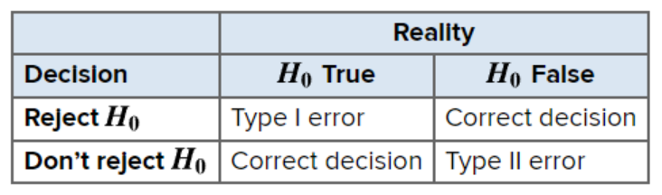
Type I and Type II Errors
Type I Error – “False positive.” We reject a null hypothesis that is actually true in real life. That’s like putting an innocent person in jail. It results in a false conclusion.
Type II Error – “False negative.” We fail to reject a null hypothesis that is actually false in real life. That’s like letting a guilty person back on the streets. It results in no conclusion being made about the data at hand.

Slide 11
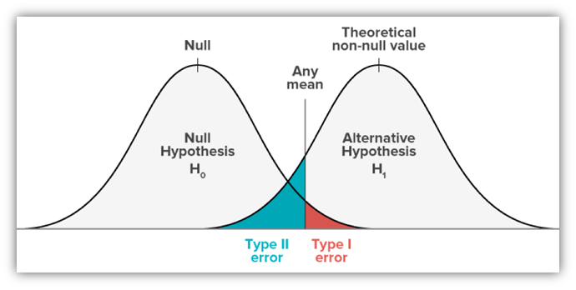
Probability of Error
P(type I error) = α also called “significance level”
P(type II error) = β

Slide 12
Practice: Determine if there is an error and if so, what kind.
H0: μ=100
H1: μ≠100
The null hypothesis is rejected. The true value of µ is 150.
H0: p=0.18
H1: p>0.18
The null hypothesis is not rejected. The true value of p is 0.20.
H0: μ=3
H1: μ<3
The null hypothesis is rejected. The true value of µ is 3.

Slide 13
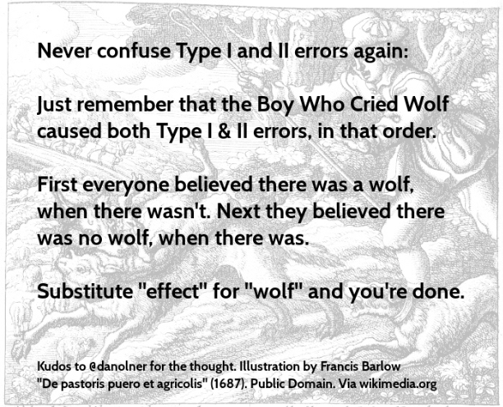
The Boy Who
Cried Wolf

Slide 14
Steps for Any Hypothesis Test
State the null and alternate hypotheses.
Gather your evidence (sample statistics).
Convert the important information into a test statistic.
Calculate your p-value (the probability of obtaining your test statistic, given that the null hypothesis is true).
Compare your p-value to the given significance level, α.
  If the p-value ≤ α, then we reject the null and accept the alternate.
  If the p-value is > α, then we fail to reject the null and reject the alternate.
State your conclusion (just like the examples in these notes).

Slide 15
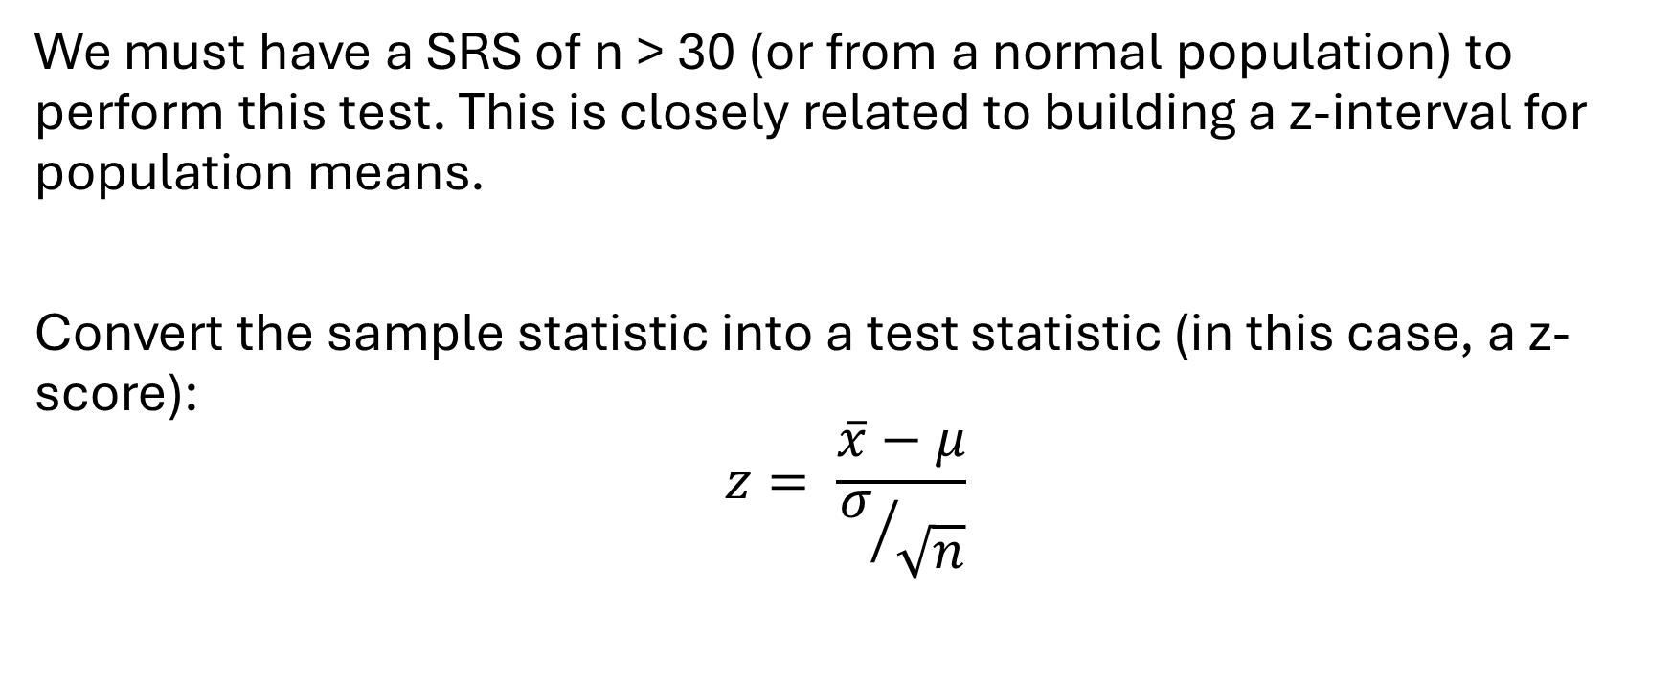
Hypothesis Testing for Means (σ known)
We must have a SRS of n > 30 (or from a normal population) to perform this test. This is closely related to building a z-interval for population means.
Convert the sample statistic into a test statistic (in this case, a z-score):
$$z= \frac{\overline{x}−μ}{σ/{\sqrt{n}}}$$

Slide 16
Sociology Example
A sociologist predicts that the mean number of years of education for adults in her city is greater than 12 years. Out of a random sample of 100 adults, she finds the sample mean years of education is 12.98. Assume the population standard deviation is 3 years. Follow these steps to perform a hypothesis test for means, given that we know sigma. Use a significance level of α = 0.05. (Draw a picture and write out each step.)

Slide 17
Sociology Conclusion
Since the p-value (P=0.0005) is less than alpha of 0.05, we reject the null hypothesis and accept the alternate. There IS sufficient evidence to suggest that the mean years of education is higher than 12.

Slide 18
All About Probability
The literal interpretation of this p-value: IF the true population mean really is 12, then the probability that we obtained a sample mean of 12.98 is 0.0005 (0.05%)! Since the probability is so small (rare, unusual), it gives us reason to doubt the null hypothesis.

Slide 19
Example With No Context
A test is made of H0: µ=5 versus H1: µ<5 from a sample of size 87, a sample mean of 4.5 is calculated. The population standard deviation is 25. Is the null hypothesis rejected at a significance level of 0.05? What about 0.10?

Slide 20
Example With No Context – Conclusion
A test is made of H0: µ=5 versus H1: µ<5 from a sample of size 87, a sample mean of 4.5 is calculated. The population standard deviation is 25. Is the null hypothesis rejected at a significance level of 0.05? What about 0.10?
Since the p-value (P=0.426) is greater than alpha of 0.05, we fail to reject the null hypothesis and therefor reject the alternate. There IS NOT sufficient evidence to suggest that the mean is less than 5. (We would come to the same conclusion with a significance level of 0.10.)

Slide 21
Machine Calibration Example
To calibrate a scale, scientists use a weight that is known to weigh exactly 1,000 grams. After 50 repeated experiments of placing this weight on the scale, the sample mean weight resulted in 1,000.6 grams. The population standard deviation of scale readings is known to be 2 grams. Perform a hypothesis test at the significance level 0.01 to determine if the mean scale reading is different than 1,000 grams.

Slide 22
Machine Calibration Conclusion
With a p-value of 0.0339, which is greater than alpha of 0.01, we fail to reject the null hypothesis and therefor reject the alternate. There is not sufficient evidence to suggest that the population mean scale reading is different than 1,000 g. In other words, there is not a problem with the scale. However, if we used alpha of 0.05, our decision would be the opposite.

Slide 23
Special Note About Two-Tailed Tests
When we have a two-tailed test, we must double our p-value, since we are calculating the probability that our sample result is significantly higher or lower than the null hypothesis parameter.
If z is positive, then lower.tail = FALSE.
If z is negative, then lower.tail = TRUE.

Slide 24
Water Safety Example
The EPA requires that our drinking water has less than 15 micrograms of lead per liter. Here are lead readings from 12 water samples (that come from a normally distributed population with a standard deviation of 3). Conduct a hypothesis test at the 0.01 significance level to determine if the water is safe to consume.
11.4, 12.4, 13.9, 8.6, 11.2, 10.5, 14.5, 17.1, 15.2, 9.8, 8.1, 15.9

Slide 25
Water Safety Conclusion
The sample mean of 12.38 is statistically significant. Since the p-value of 0.0013 is less than alpha 0.01, we reject the null hypothesis and accept the alternate. There is sufficient evidence to suggest that the population mean amount of lead is less than 15 micrograms/liter and is safe to drink.

Slide 26
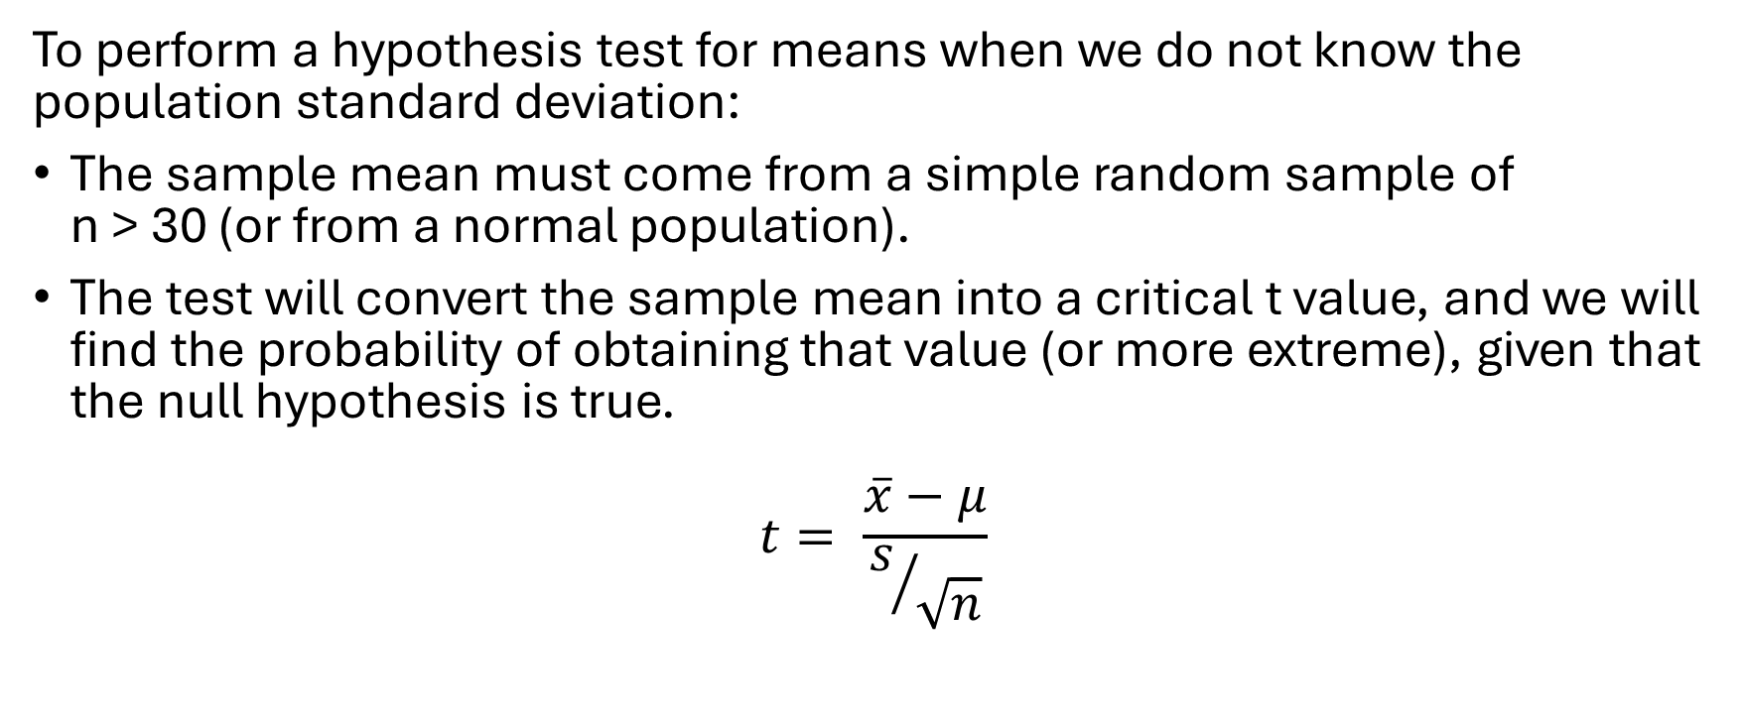
Hypothesis Testing for Means (σ NOT known)
To perform a hypothesis test for means when we do not know the population standard deviation:
The sample mean must come from a simple random sample of
n > 30 (or from a normal population).
The test will convert the sample mean into a critical t value, and we will find the probability of obtaining that value (or more extreme), given that the null hypothesis is true.
$$t= \frac{\overline{x}−μ}{s/{\sqrt{n}}}$$

Slide 27
Physician Salary Example
It is reported that the mean salary of family practitioners in the U.S. is $178,258. A random sample of 55 family practitioners from L.A. had a sample mean of $192,340 with a standard deviation of $42,387. Is this evidence that the mean salary for practitioners in L.A. is greater than the national average? Use a significance level of 0.05.

Slide 28
Physician Salary Conclusion
Because the p-value (P=0.0085) is less than the significance level 0.05, we reject the null hypothesis and accept the alternate. There is enough evidence to suggest that the population mean salary for doctors in L.A. is greater than $178,258.

Slide 29
Hypothesis Testing via Confidence Intervals
If the confidence level is 95%, then the significance level is 5%
(α = 0.05). The confidence level and alpha are complements of one another.
If you build a 95% confidence interval that contains the parameter as defined by the null hypothesis, then there is no reason to reject the null hypothesis.
However, if it does not contain the parameter as defined by the null hypothesis, then there is evidence to reject the null and accept the alternate hypothesis.

Slide 30
The Probability of an Error
The significance level alpha is the same as the probability of a type I error. P(Type I Error) = α
If our sample statistic falls in the rejection region (the area under the curve equal to alpha), then we have reason to reject the null hypothesis. There is always a chance that the null hypothesis is actually true, so this is the probability that we reject a true null, which is a type I error.
If we’re 95% confident that a true population mean lies between a and b, that means our success rate of capturing the parameter is 95%. There must be a failure rate of 5%.

Slide 31
Diamonds Example via Hypothesis Test
The weight of diamonds is measured in carats. From a sample of 12 diamonds in a certain retail store, the mean was 1.16 carats with a standard deviation of 0.14 carats. Assume the population is normally distributed. Perform a hypothesis test with a significance level of 0.10 to determine whether the mean diamond weight from this store is less than 1.5 carats.

Slide 32
Diamonds Example via H.T. Conclusion
With a p-value of 2.02x10^-6 (P=0.000002), we reject the null hypothesis and accept the alternate. There is sufficient evidence to suggest that the population mean diamond weight at this retailer is less than 1.5 carats. The p-value could also be printed as (P<0.0001).

Slide 33
Diamonds Example via Confidence Interval
Build a 90% confidence interval to estimate the population mean diamond weight from the same data in the previous problem. What is your conclusion? Does this align with your findings based on the hypothesis test?

Slide 34
Diamonds Example via C.I. Conclusion
We are 90% confident that the population mean diamond weight is between 1.09 and 1.23 carats. The population mean as defined by the null hypothesis, 1.5, is not inside this interval. (The entire interval is less than 1.5.) Therefore, we will reject the null hypothesis.

Slide 35
TV Survey Example
A social survey asked 1,298 people how much time they watch TV daily. The sample mean was 3.09 hours with a standard deviation of 2.87 hours. A sociologist claims that the population mean time is three hours per day. Does the sample data support or contradict this claim? Use an alpha level of 0.01.

Slide 36
TV Survey Conclusion
With a large p-value (P=0.2588), we fail to reject the null hypothesis. There is not enough evidence to suggest that the population mean hours watched is any different than 3 hours.

Slide 37
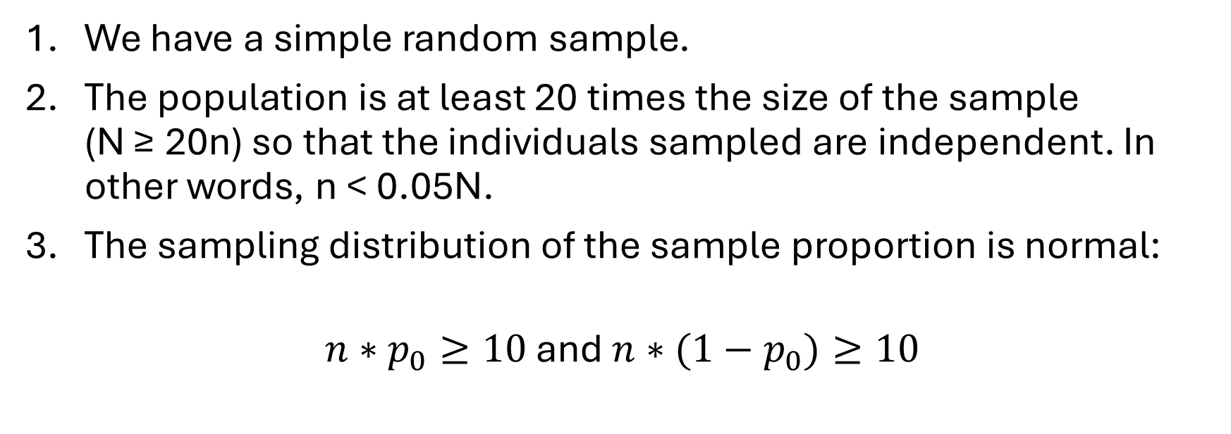
Hypothesis Tests for Proportions - Assumptions
We have a simple random sample.
The population is at least 20 times the size of the sample
(N ≥ 20n) so that the individuals sampled are independent. In other words, n < 0.05N.
The sampling distribution of the sample proportion is normal:
$n∗p_{0}≥10$ and $n∗{(1−p}_{0})≥10$

Slide 38
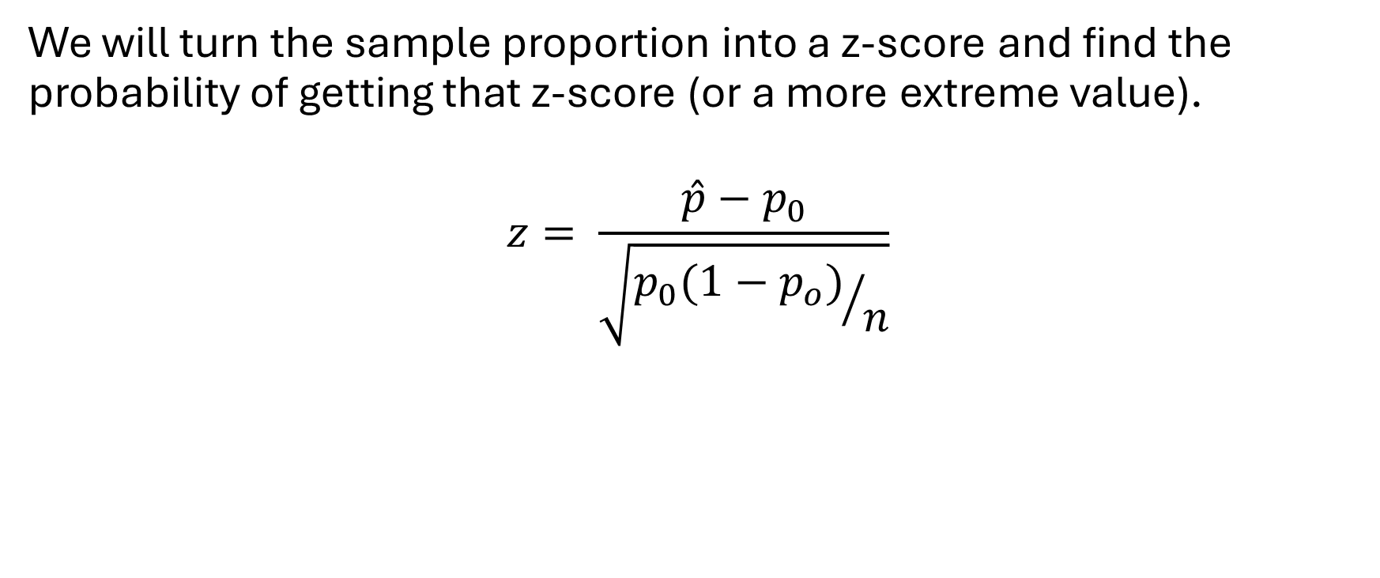
Test Statistic for Proportions
We will turn the sample proportion into a z-score and find the probability of getting that z-score (or a more extreme value).
$$z= \frac{\hat{p}−p_{0}}{\sqrt{{p_{0}(1−p_{o})}/n}}$$

Slide 39
Spam Example
SecureList claims that 71.8% of all emails are spam. A system manager at a large company thinks that the percentage for their workplace is closer to 80%. From a simple random sample of 500 emails, he finds that 382 messages are spam. What is your conclusion based on a significance level of 0.05? What about using alpha = 0.01?

Slide 40
Spam Example Conclusion
Because the p-value (P=0.0111) is less than the significance level 0.05, we reject the null hypothesis and accept the alternate. There IS enough evidence to suggest that the population proportion of spam messages is greater than 0.718.
Because the p-value (P=0.0111) is greater than the significance level 0.01, we fail to reject the null hypothesis and reject the alternate. There IS NOT enough evidence to suggest that the population proportion of spam messages is greater than 0.718.

Slide 41
Cell Phone Example
A phone company claims that roughly 55% of kids (8-12 years old) have their own phone. In a survey of 802 children in this age group, 449 were found to have their own phones. Can you conclude that the company’s claim is true at the 0.10 significance level?

Slide 42
Cell Phone Example Conclusion
With such a large p-value (P=0.5750), we fail to reject the null hypothesis. There is no evidence to doubt the company's claim. In other words, there is not sufficient evidence that the population proportion of kids who have their own phone is different than 55%.

Slide 43
Football Example
Viktor wonders if there is a home-field advantage for high school football players in his county. The records of the past decade indicate that out of 780 matches, 445 victories were held on the home team’s field. Is this sufficient evidence to prove a home-field advantage?

Slide 44
Football Example Conclusion
The small p-value (P<0.0001) indicates that we should reject the null hypothesis. There is sufficient evidence that there is a home-field advantage for high school football players in this county.

